Slide 1
MLOps Developing models
Università di Modena e Reggio Emilia
Prof. Nicola Bicocchi (nicola.bicocchi@unimore.it)

Slide 2
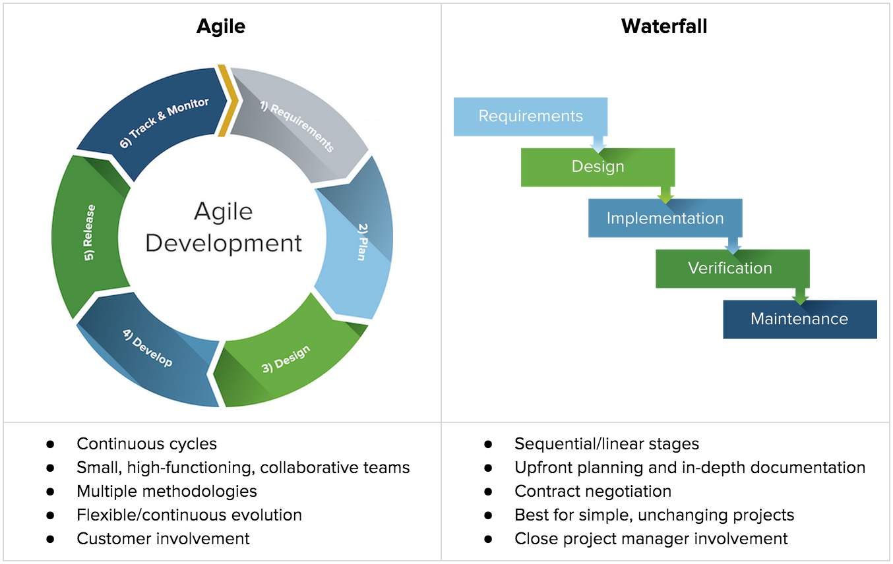
Software Lyfecycle

Slide 3
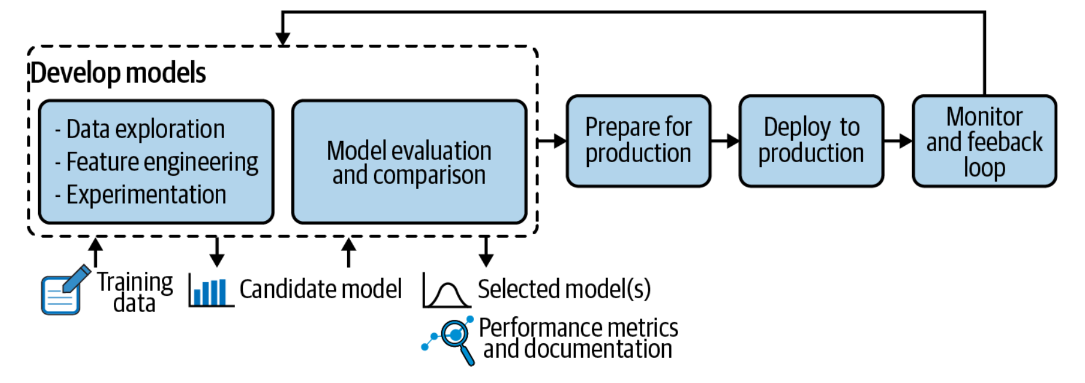
ML Lifecycle

Slide 4
Data exploration
Domain knowledge is required
Documenting how the data was collected and what assumptions were already made
Looking at summarizing statistics of the data: What is the domain of each column? Are there some rows with missing values? Obvious mistakes? Strange outliers? No outliers at all?
Taking a closer look at the distribution of the data
Cleaning, filling, reshaping, filtering, clipping, sampling, etc.
Checking correlations between the different columns, running statistical tests on some subpopulations, fitting distribution curves
Comparing that data to other data or models in the literature: Is there some usual information that seems to be missing? Is this data comparably distributed?

Slide 5
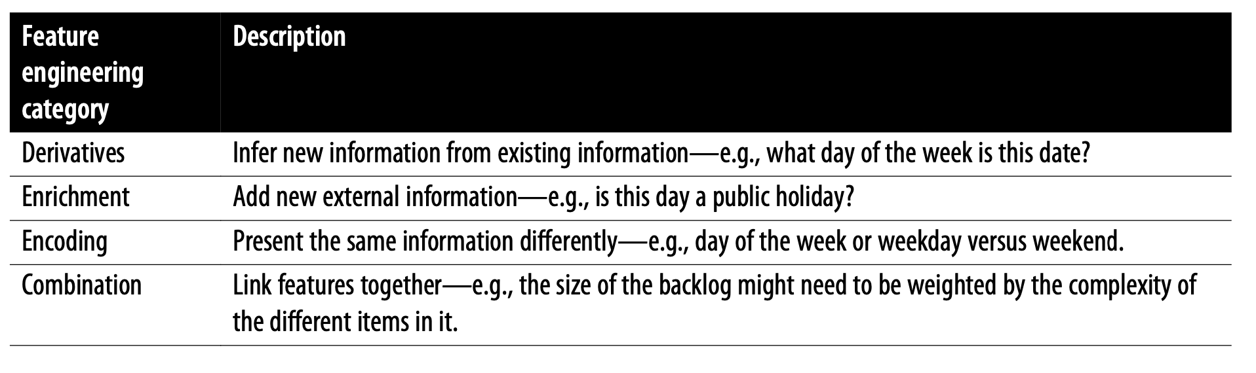
Features engineering
Features are how data is presented to a model, serving to inform that model on things it may not infer by itself. This table provides examples of how features may be engineered:

Slide 6
Feature Engineering Impacts
Benefits of adding more features:
Produce a more accurate model
Achieve more fairness when splitting into more precise groups
Compensate for some other useful missing information
Downsides:
The model can become more expensive to compute.
More features require more inputs and more maintenance down the line.
More features mean a loss of some stability.
The sheer number of features can raise privacy concerns.
Automated feature selection can help by using heuristics to estimate how critical some features will be for the predictive performance of the model.
Tools such as Auto-sklearn or AutoML applications cross-reference features against a given target to estimate which features, derivatives or combinations are likely to yield the best results.
The bottom line is that when building models, the process of engineering and selecting features, like many other ML model components, is a delicate balance between considering MLOps components and performance.

Slide 7
*Features engineering
One-hot encodings
Embeddings
Transfer learning

Slide 8
Experimentation
Experimentation takes place throughout the entire model development process, and usually, every important decision or assumption comes with at least some experiment or previous research to justify it.
It can take many shapes, from building full-fledged predictive ML models to doing statistical tests or charting data.
Assessing how useful or how good a model can be built
Finding the best modeling parameters (algorithms, hyperparameters, feature pre-processing, etc.).
Tuning the underfitting/overfitting trade-off for a given training cost
Finding a balance between model improvement and improved computation costs. (Since there’s always room for improvement, how good is good enough?)

Slide 9
Experimentation
Trying all combinations of every possible hyperparameter, feature handling, etc., quickly becomes untraceable. Therefore, it is useful to define a time and/or computation budget for experiments as well as an acceptability threshold for the usefulness of the model.
Fortunately, more and more data science and machine learning platforms allow for automating these workflows not only on the first run but also to preserve all the processing operations for repeatability. Some also allow for the use of version control and experimental branch spin-off to test theories and then merge, discard, or keep them

Slide 10
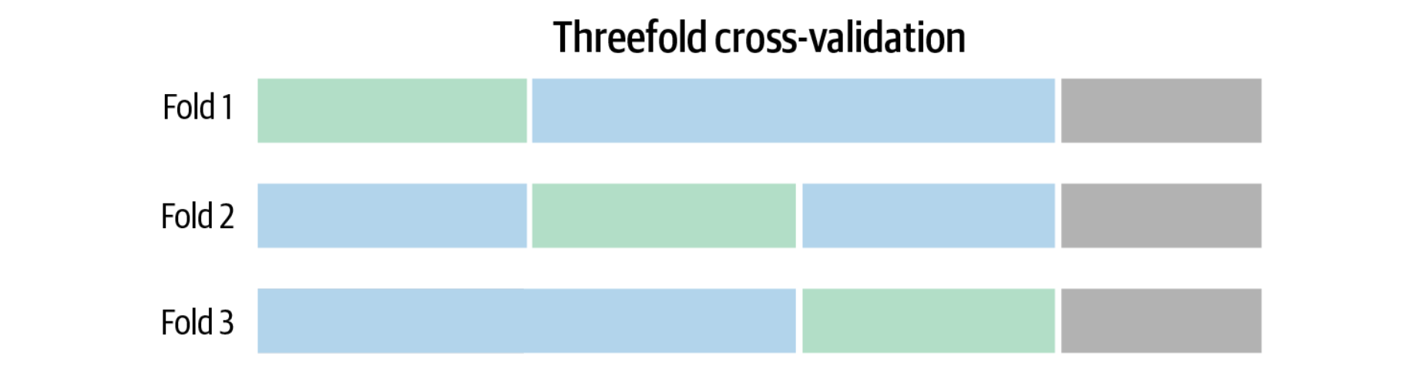
Model evaluation
George E. P. Box, a twentieth-century British statistician, once said that all models are wrong, but some are useful.
A model with an absolute performance that could technically be disappointing can still possibly enhance an existing situation.
Conversely, a model that gets a perfect score is suspicious, as most problems have noise in the data that is somewhat hard to predict. A perfect or nearly-perfect score may be a sign that there is a leak in the data or that the model overfits the training data.

Slide 11
Version Management and Reproducibility
During the experimentation phase, data scientists may find themselves going back and forth on different decisions, trying out different combinations, and reverting when they don’t produce the desired results. That means having the ability to go back to different “branches” of the experiments—for example, restoring a previous state of a project when the experimentation process led to a dead end.
Data scientists or others (auditors, managers, etc.) may need to be able to replay the computations that led to model deployment for an audit team several years after the experimentation was first done.

Slide 12
Version Management and Reproducibility
Another very important property of a model is reproducibility.
Operationalization necessitates model reproduction not only in another environment but also possibly from a different starting point.
Assumptions
Randomness
Data
Settings
Results
Implementation
Environment

Slide 13
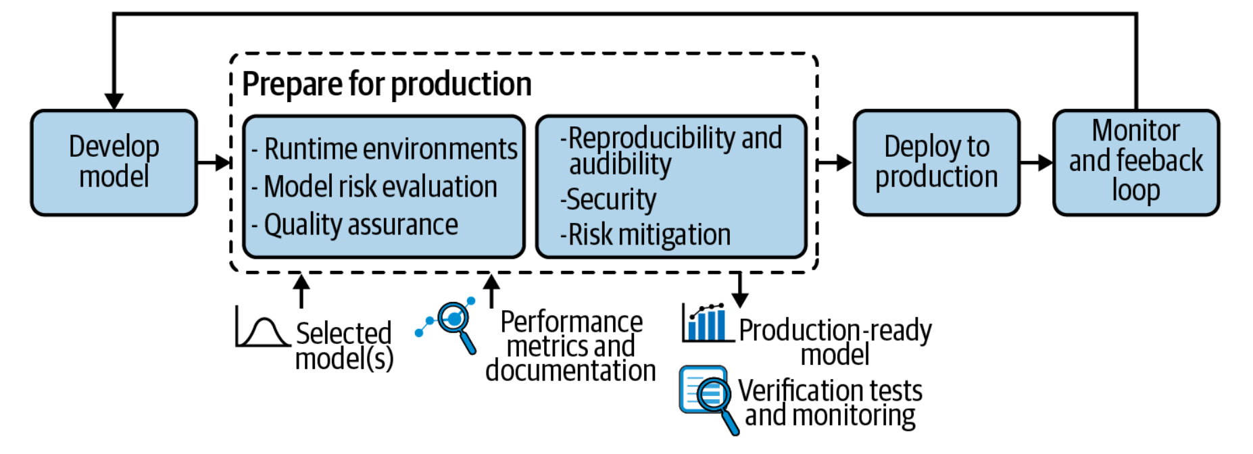
Preparing for Production

Slide 14
Preparing for Production
Production environments take a wide variety of forms: custom-built services, data science platforms, dedicated services like TensorFlow Serving, low-level infrastructure like Kubernetes clusters, JVMs on embedded systems, etc.
To make things even more complex, consider that in some organizations, multiple heterogeneous production environments coexist.
Ideally, models running in the development environment would be validated and sent as is to production; Unfortunately, this ideal scenario is not always possible, and it’s not unheard of for teams to finish a long-term project only to realize it can’t be put in production.

Slide 15
Tooling considerations
The format required to send to production should be considered early. For example, when a model is developed using scikit-learn (Python) and pro-duction is a Java-based environment that expects PMML or ONNX as input, conversion is required.
Teams should set up tooling while developing the model, ideally before the first version of the model is finished or even started.
Failure to create this pipeline up front would block the validation process (and, of course, final validation should not be performed on the scikit-learn model, as it’s not the one that will be put into production).

Slide 16
Performance considerations
Python -> C++ 10X faster
Deep neural networks on constrained devices
Quantization, the model can be trained using 32-bit floating-point numbers and used for inference at a lower precision so that the model requires less memory and is faster.
Pruning, weights are removed (or even entire layers) from the neural network. This is a rather radical approach, but some methods allow for the preservation of accuracy.
Distillation, a smaller “student” network is trained to mimic a bigger, more powerful network. Done appropriately, this can lead to better models (as compared to trying to train the smaller network directly from the data).

Slide 17
Performance considerations
Training a model usually requires a high level of software sophistication, massive data volumes, and high-end machines with powerful GPUs.
In the whole life cycle of a model, there is a good chance that most of the computing is spent at inference time.
Scaling inference on complex models can be expensive and have significant energy and environmental impact.
A valuable practice to control complexity in production is to develop complex models only to provide a baseline. What goes into production can then be a much simpler model, with the advantages of lowering the operating risk, increasing computational performance, and lowering power consumption

Slide 18
Data Access Before Validation
For example, a model evaluating apartment prices may use the average market price in a zip code area; however, the user requesting the scoring will probably provide simply the zip code, meaning a lookup is necessary to fetch the value of the average.
Data can be frozen and bundled with the model. But when this is not possible (e.g., if the dataset is too large or the enrichment data needs to always be up to date), the production environment should access a database and thus have the appropriate network connectivity, libraries, or drivers required to communicate with the data storage installed, and authentication credentials stored in some form of production configuration.

